Slide 1
Presentation title
Subtitle or short description of the topic
Name · Department · Date

Slide 2
How to use this template
1
New slide
Go to Home › New Slide and pick one of the nine DANREC layouts.
Brand colours
Dark Blue
#00274C
Medium Blue
#335C81
Light Blue
#6C7A89
2
Type in the placeholders
Font, size and colours are set automatically. Don't move the logo or slide number.
Use the brand colours
The theme colours sit at the top of the colour picker – use only those.
Creme
#F8F3EF
Grey
#848484
Black
#000F22
3
Typeface
4
Pictures
Use a picture layout and take photos from the photo library at the back of the template.
Century Gothic Bold
Headings and emphasis
Century Gothic Regular
Body text and subheadings
Notes:
Guide slide – delete this slide before using the presentation.

Slide 3
Section title
01
A short line explaining what this part is about

Slide 4
Title and content
Use this layout for regular text and bullet points.
Keep the text short – one message per slide works best.
Use five or six bullets at most so the slide stays light.
Spell product names as in the brand book, e.g. DAN-Board Xtreme and Terra-Grid E® 35.

Slide 5
Two columns
Before
After
Suited to comparisons, before/after or two topics side by side.
Each column has its own heading.
Keep the two columns roughly the same length.
The headings can be changed freely.

Slide 6

Picture and text
Right-click the picture and choose Change Picture to insert your own. The picture is cropped to fit the frame automatically. Photos of products, production and people work well.

Slide 7

Text and picture
The same layout with the picture on the right. Alternate between the two variants to give the presentation rhythm.

Slide 8
Key figures
00 %
00 %
00 %
First key figure
Short explanation of what the figure shows
Second key figure
Short explanation of what the figure shows
Third key figure
Short explanation of what the figure shows
Notes:
The Title Only layout is a free canvas – use it for key figures, charts, tables and pictures.

Slide 9
A short, strong quote from a customer, an employee or management works best here.
First Last, title

Slide 10

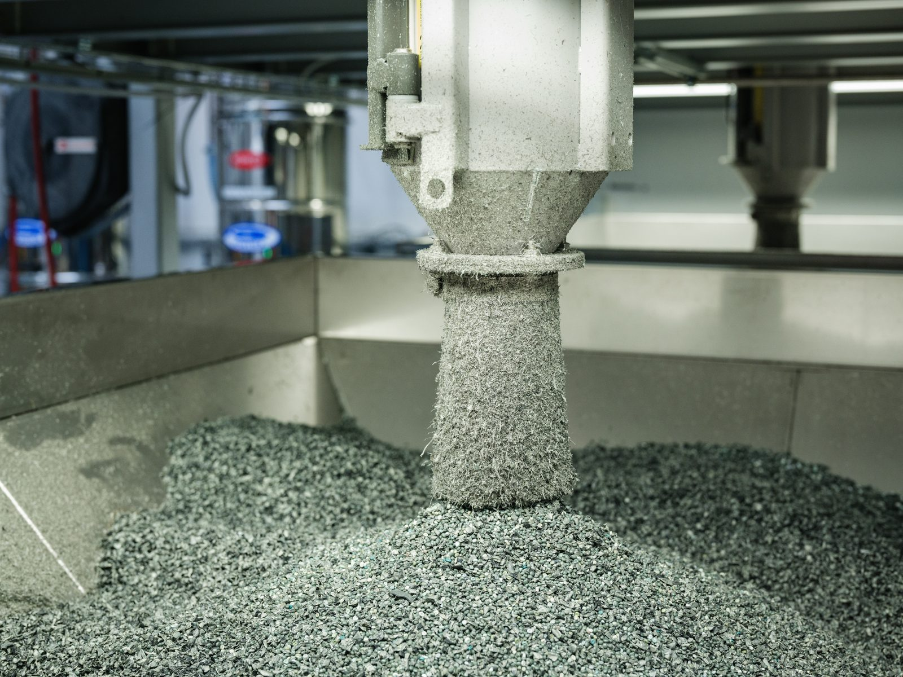
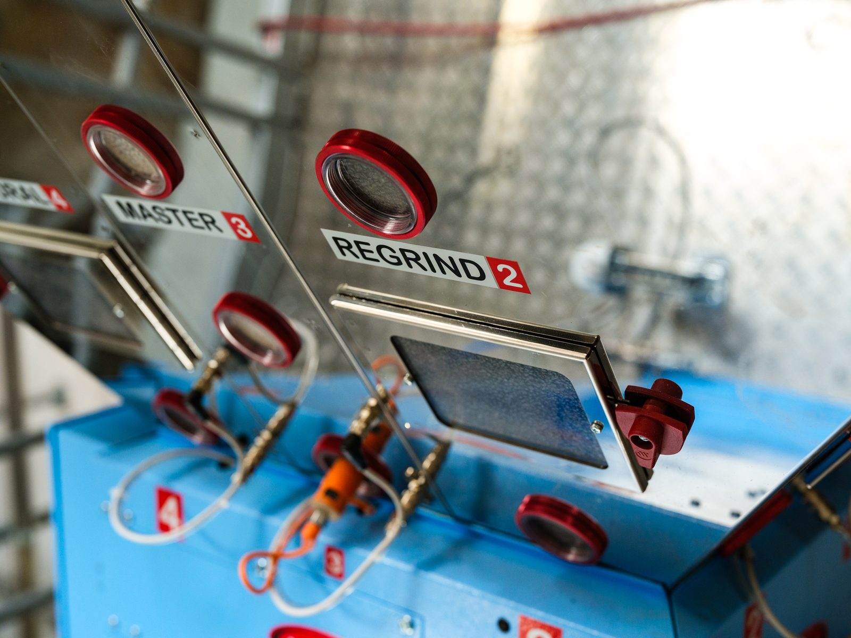
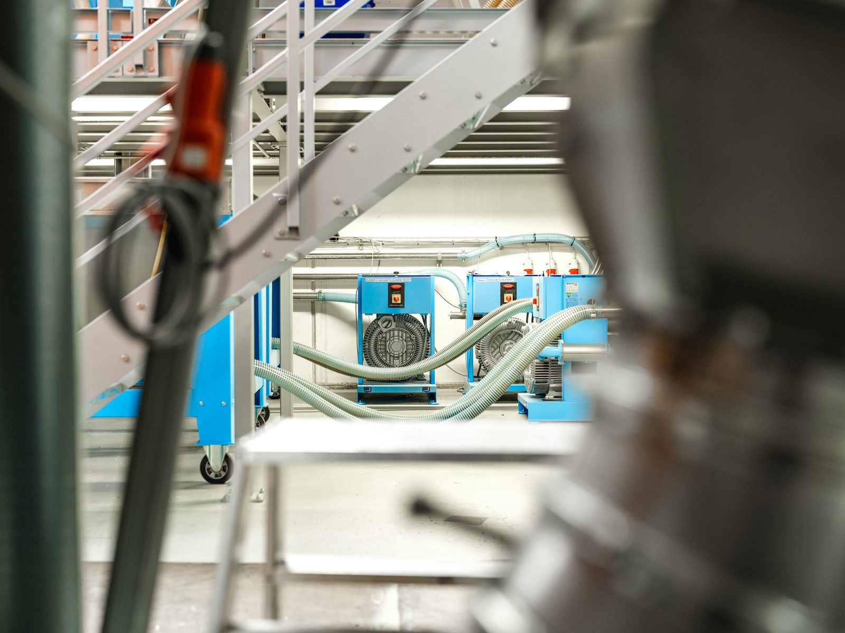




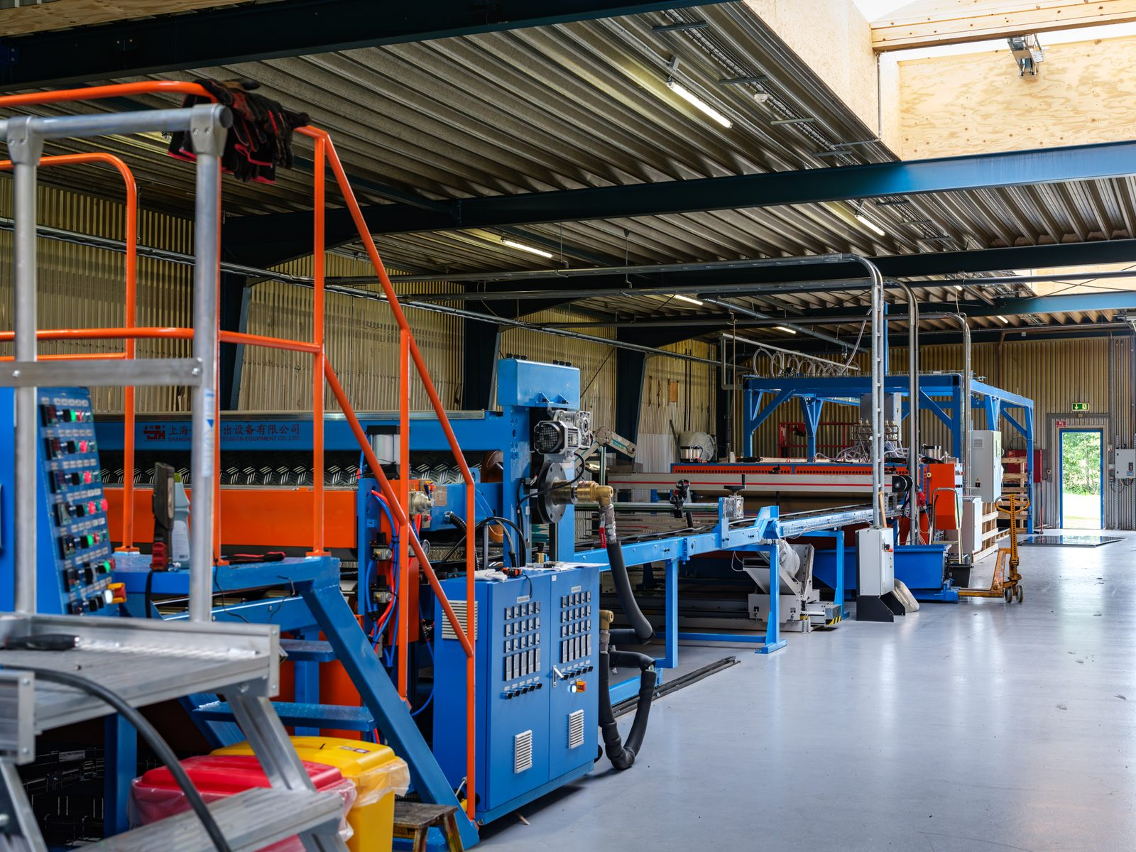








Photo library
Copy a photo onto your slide. Use Crop to show the whole picture.
Notes:
Photo library – all photos are stored at full size in the file. Delete this slide before using the presentation.

Slide 11
Thank you
First Last · Title
email · phone

